Slide 1
DATA SCIENCE FOR ECONOMISTS
ECON 220 LAB
Jafet Baca-Obando
Week 6, Handling IPUMS data – 10/03/2025

Slide 2
Outline
01 | Introduction to IPUMS
02 | Dummy variables
03 | Categorical variables

Slide 3
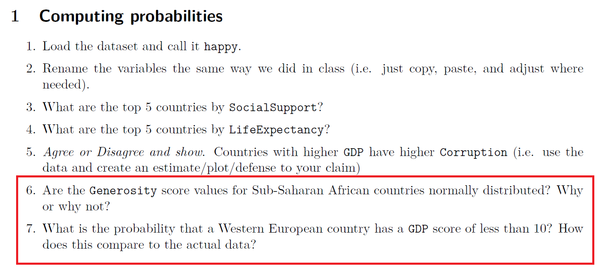
Announcement
Items 6 and 7 of Data Exercise 3 will be worth extra credit if correct (2 points)

Slide 4
What is IPUMS?
Integrated Public Use Microdata Series​
Operated by the University of Minnesota
Core mission: data harmonization
IPUMS takes datasets that were originally collected with different questions, codes, and variable names and makes them consistent. Lots of recoding!
Free access!​
By providing access to detailed, anonymized individual-level data (microdata), IPUMS allows researchers to ask complex questions that can't be answered with aggregated summary tables.

Slide 5
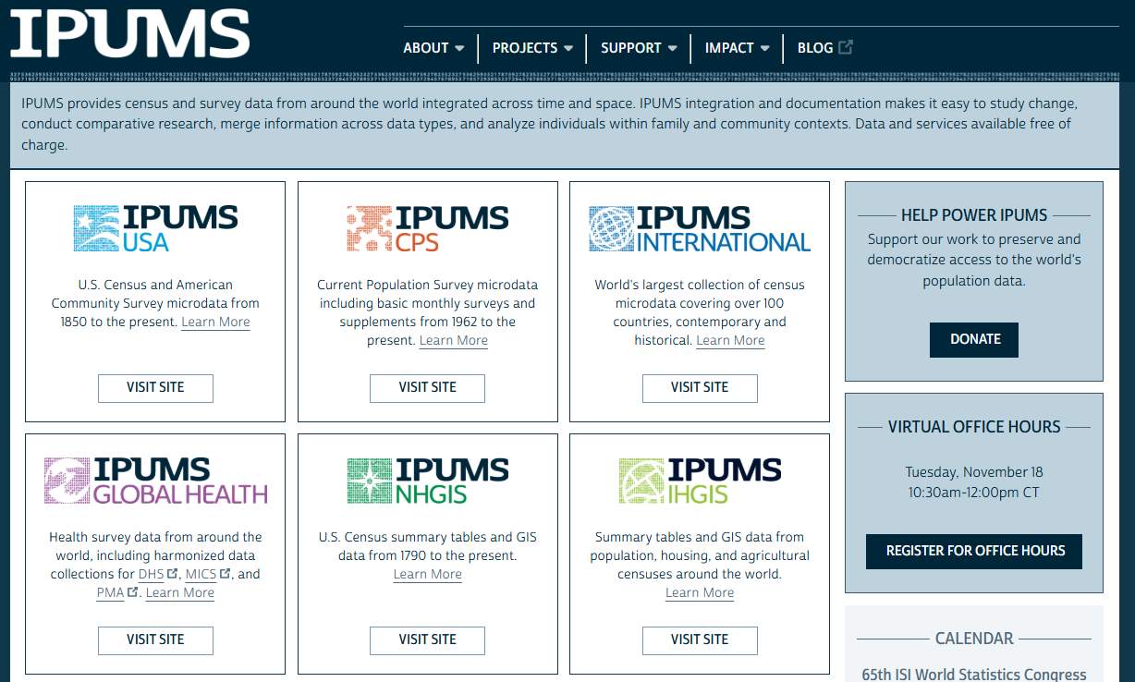

Slide 6
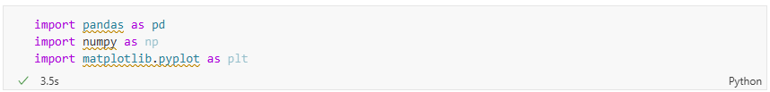
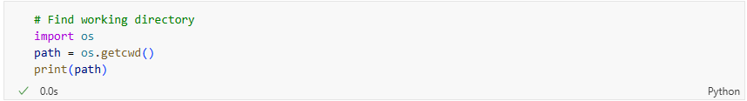
Importing required libraries and dataset
New package to find the path: os

Slide 7
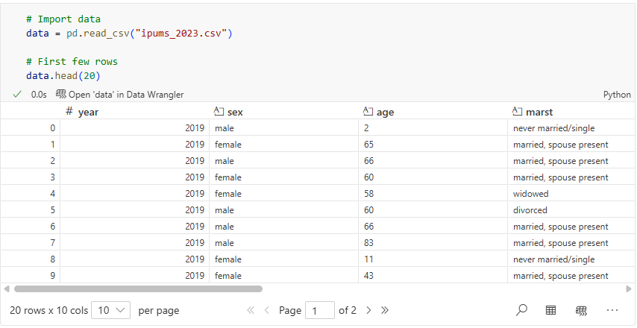
Load the data

Slide 8
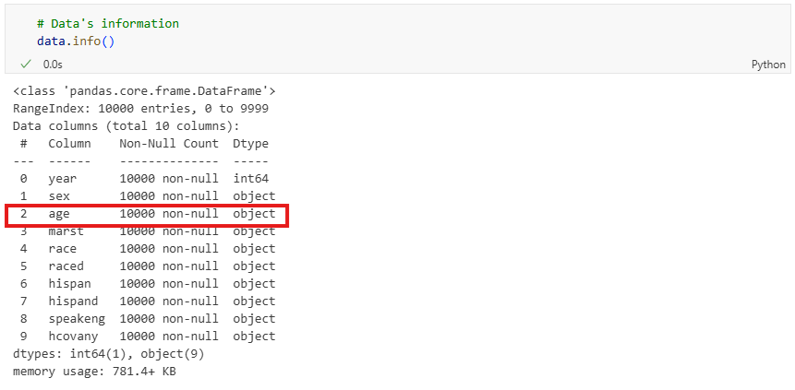
Debugging 101: Why is age an object?

Slide 9
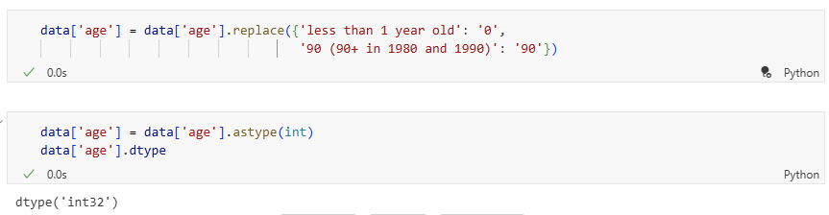
Correcting issue with .replace()

Slide 10
Dummy variables
Binary variable used to represent categorical data.
It takes a value of 1 if a certain characteristic is present and 0 if it is not.
For example, in a dataset of workers, we could create a female dummy where female = 1 for women and female = 0 otherwise.

Slide 11
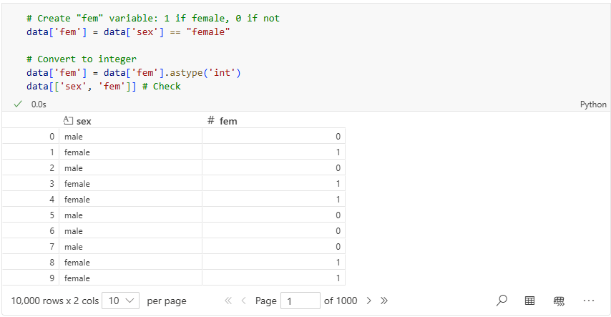
Dummy variable female

Slide 12
Categorical variables
They represent distinct groups or categories.
These variables can be nominal (no natural order), or ordinal (with a meaningful order)
Examples:
  Education Level: "High School," "Bachelor's," "Master’s”
  Region: "North," "South," "East," "West“
  Credit Rating: "Poor," "Fair," "Good," "Excellent"

Slide 13
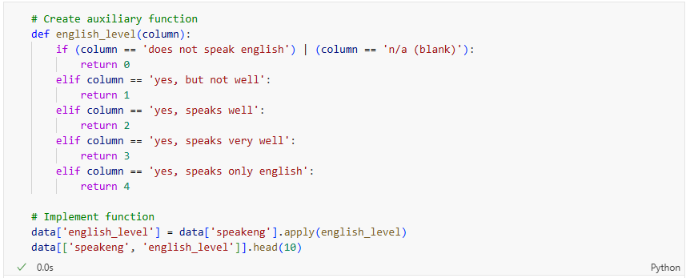
Example – Categorizing English proficiency

Slide 14
Recap
We handled IPUMS data.
Introduced the concepts of dummy and categorical variables.
Implemented a few coding examples.

Slide 15
To-do list
Complete Data Exercise 3
  Upload Jupyter notebook (.ipynb file) and HTML file on October 5
Complete Data Exercise 4
  Upload Jupyter notebook (.ipynb file) and HTML file on October 12

